Slide 1
Game Programming I Week 3
Images, Simple Animation, Fonts
Notes:
Title with bullet points

Slide 2
Announcements

Slide 3
Active Clubs
Game Design Club
Digital Collective Animation Club
Video Game Club

Slide 4
Upcoming Events
All Majors Meeting - (mandatory!)
9/28 - 5:15-6:30 - Savoy Multi-Purpose Room
DUM-D Animation Festival
9/26-27 - Hostos
NYU Game Center Lecture Series
Robert Yang - 9/28 (Queer Game Designer / Games Academic)
David O’Reilly - 10/26 (Indie Game Designer, Everything)
Jane Ng - 11/30 (Firewatch Environmental Artist)
http://gamecenter.nyu.edu/event/nyu-game-center-lecture-series-presents-robert-yang/

Slide 5
Review
(cough, cough)

Slide 6
declaration;
ONCE
ONCE
LOOP
void setup() { our code goes here; //we comment here } void draw() { our code goes here; //we comment here }

Slide 7
Data types
int
whole numbers
1, 2, -3, 40, 2013
float
floating point number (decimal points)
0.5, 1.34, 11.5, 7.0/2.0

Slide 8
Data types
String
ASCII characters, declared in quotation marks
"lemon", "meringue", "pie"
boolean
true, false
color
colors; by default uses RGB
(255, 177, 80)

Slide 9
Variables are declared and initialized(assigned).

Slide 10
Structure
Declarations
int x; //declare a variable for x
float y; //declare a variable for y
Notes:
"The first part of the code is going to contain variable declarations which you've already learned. As we go on, other things will appear here in the beginning such as the creation of objects and other pieces of code.
It is important to note that variables declared here are considered "global" variables, meaning they will be accessible to all of the code in the entire sketch. We will show examples of "local" variables later and how you might run into problems, but you should be putting all of your important variables here at the beginning"

Slide 11
Structure
Declarations
Initialization
(initial assignment)
int x; //declare a variable for x
float y; //declare a variable for y
void setup() {
size(500,500);
x = 0; //initialize x to 0
y = 5.3; //initialize y to 5.3
}
Notes:
"This part should look a little new. The first real part of the dynamic code structure is the setup. Everything between the two curly brackets will run only once at the very beginning of the sketch. This is where you will want to put things that set up your sketch such as size of the applet window, background color, loading images into the sketch (so that you aren’t loading images over and over, slowing down your program), etc.
MAKE REFERENCE TO THESE PIECES BEING MODULES/CHUNKS OF CODE
It is also good practice to "initialize" your variables here. This is actually loading values into your variables so that your sketch runs the way it needs to. Some variables might need to be initialized while others might not. It can be done in the initial declarations (for ex. "int x = 3;") but it is good practice to put them in the setup.
Note the syntax used: open and closed parentheses in addition to the curly brackets. If you have a foreign keyboard make sure you know how to use these.

Slide 12
Structure
Declarations
Setup
Draw
int x; //declare a variable for x
float y; //declare a variable for y
void setup() {
size(500,500);
x = 0; //initialize x to 0
y = 5.3; //initialize y to 5.3
}
void draw() {
ellipse(50, 200, x, x); //draw a circle
rect(100, 100, 30, 50); //draw a rectangle
}
Notes:
The Draw loop is where the meat of your sketch will go. Things between these curly brackets will run one line at a time from start to finish then loop back again to the beginning, running over and over again until the sketch is stopped.

Slide 13
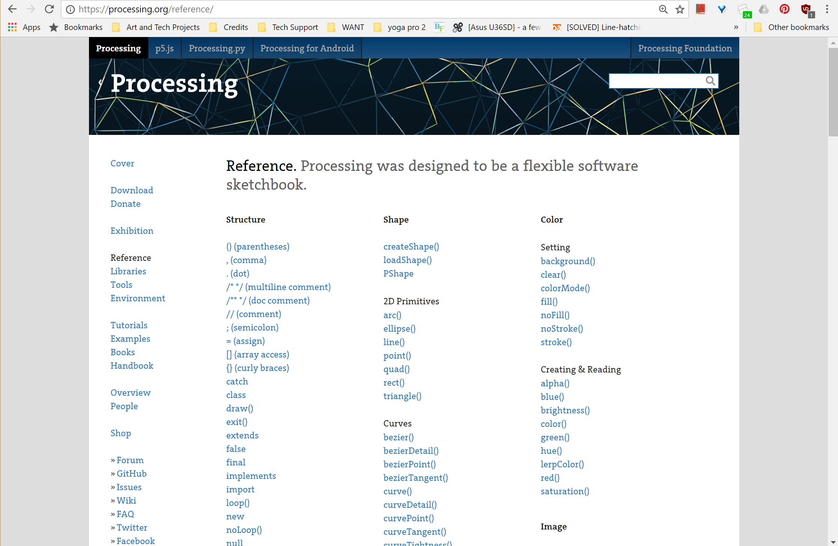
Processing Koran/Bible/Talmud/Vedas

Slide 14
Pop Quiz 1
What are the names of the 2 functions that almost all sketches use?
When does setup run and how many times does it run?
Write out a variable declaration for an integer and name it count. Imagine it's a line of code. No errors are allowed.
Initialize the variable with an assignment. It can be any valid value. No errors are allowed.
When you don't know or recall how to use a built-in processing function or variable, where do you go to find out how to use it?

Slide 15
How to draw a rectangle?
Notes:
review previous lessons: how to draw regular geometry shapes
what do we need to draw a rectangle: width, height, coordinate

Slide 16
How to draw a rectangle?
rect(0, 0, 200, 100);
Notes:
ask before giving answers
指出哪个位置代表哪个参数

Slide 17
How to draw an image?

Slide 18
How to draw an image?
A. image(0, 0, 200, 100);
B. image(“image.jpg”, 0, 0, 200, 100);
C. image(“image.jpg”, 0, 0);

Slide 19
How to draw an image?
A. image(0, 0, 200, 100);
B. image(“image.jpg”, 0, 0, 200, 100);
C. image(“image.jpg”, 0, 0);
Notes:
For example images are going to be loaded into a Processing Sketch, loading them into a PImage.
This PImage is going to act as a storing object.
This object works very similarly to the variables we saw.
You declare them first and then you can pass information in and out of them.
class & object vs. variable & value
we are going to introduce how to declare and display an image, and why it has to be like that.

Slide 20
Image
PImage

Slide 21

myImage
PImage myImage;
//Declaring a variable of type Image
img.jpg
01010
11011
00100
myImage
myImage = loadImage("image.jpg");
//Make a new instance of PImage by loading an image file
(0,0)
myImage
image(myImage, 0, 0);
//Draw an image to the screen at (0, 0)
Notes:
They are declared first.
Fill with information from a file.
And displayed in the right way
IMPORTANT NOTE: you don't have to call it myImage. You can name it whatever you want

Slide 22
Images
// declare
PImage myImage;
void setup(){
// load (in setup)
myImage = loadImage(“filename.jpg”);
}
void draw(){
// draw it at 0,0 (in draw)
image(myImage, 0, 0);
}
Notes:
https://www.processing.org/reference/image_.html
show them the definition in processing website by right clicking PImage in Processing Sketch
tell them several reasons why it has to be like this.
If they are defined like geometries, then this image will be loaded each time when it displays on the screen.

Slide 23
Example 1
Image Display

Slide 24
Image Property
image(myImage, mouseX, mouseY,
width/2, height/2);
tint(a, b, c, d);
Notes:
two other methods to change image properties;
preparation for the increment movement of image
use local variables to define the resized size of this image and explain the difference between global and local variables

Slide 25
Example 2
Image Properties
Notes:
position, size, brightness

Slide 26
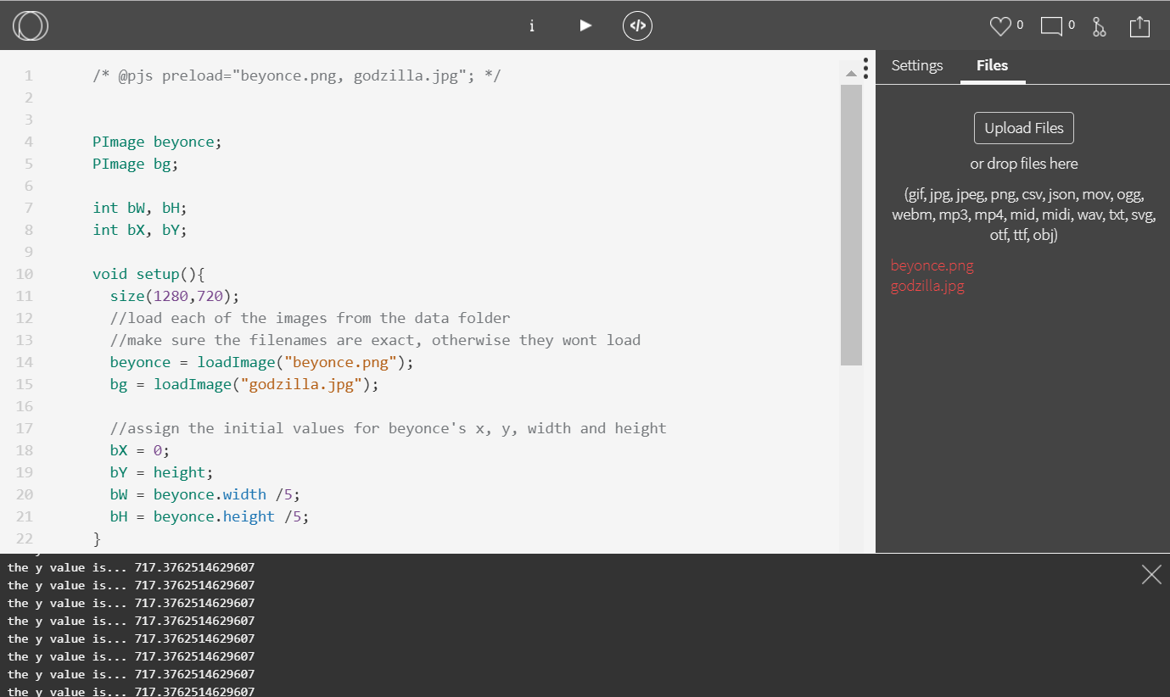
Images on OpenProcessing
Use preload code at top of sketch
Upload the image files under the Files tab on the right

Slide 27
Animation I
replace numbers with variables

Slide 28
Example 3
Image Increment
Notes:
try the wrong one: local variables to further visually explain the difference, and then use the right one: global variables to make the image move

Slide 29
Animation II
trigonometry function

Slide 30
Trigonometry
sin(); cos();

Slide 31
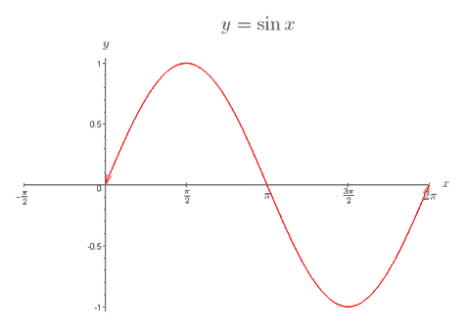
Sine Function

Slide 32
Example 4
heart pounding

Slide 33
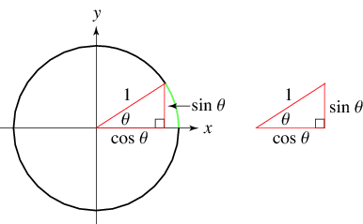
Trigonometric Functions

Slide 36
Example 5
moon revolvement

Slide 37
Text Fonts
PFont
Notes:
Let's say you want to print some text on the screen. You already know that we can do that using String variables ( http://processing.org/reference/String.html ) but we don't know how to render it into the screen.
In order to do that we need to pick up a font. Just like in any word editor.
Processing have another special object for that call PFont.

Slide 38
Fonts
// declare
PFont awesomeFont;
void setup(){
// load (in setup)
awesomeFont = loadFont(“Arial-14.vlw”);
}
void draw(){
// set which font to use. draw it at 0,0 (in draw)
textFont(awesomeFont);
text(“Hello!”, 0, 0);
}
Notes:
Very similar to PImage BUT... text() just draw text and the font have to be set just like Fill color of stroke color.
Where you can get those .vlw fonts? @#*!
https://www.processing.org/reference/PFont.html
https://www.processing.org/reference/createFont_.html
https://www.processing.org/tutorials/text/

Slide 39
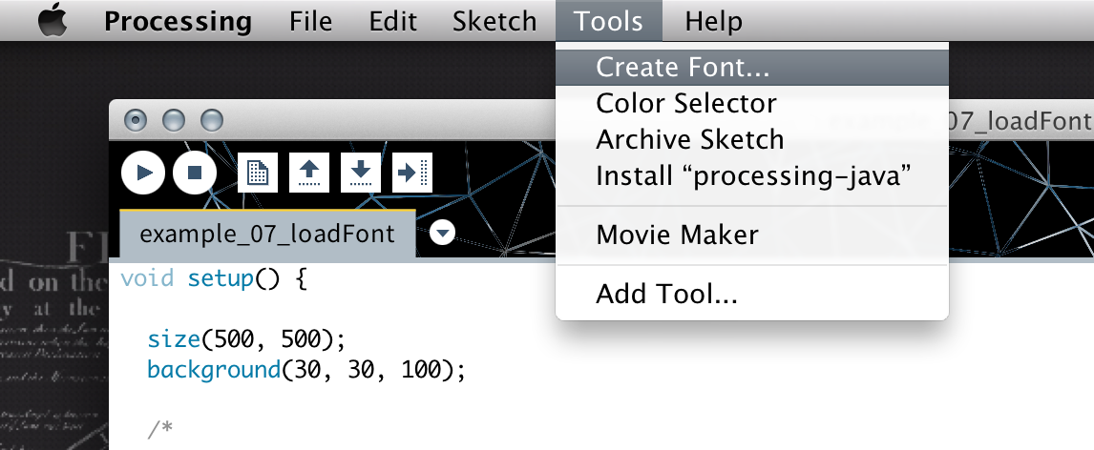
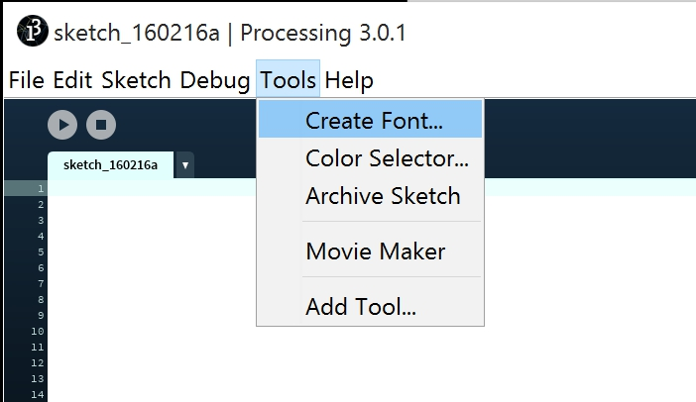
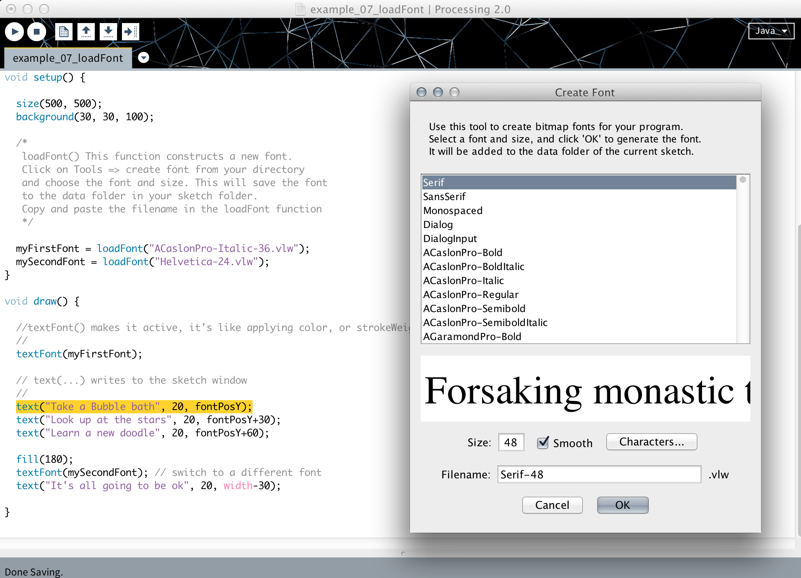
1.
2.
Notes:
More references http://processing.org/tutorials/text/
Processing.org gives walkthrough here:
- http://processing.org/reference/loadFont_.html
- http://processing.org/reference/PFont.html

Slide 40
myFont = createFont("Helvetica", 24, true);
Notes:
Also if you want to be a hardcore coder you can created your self

Slide 41
Example 6
Text Display
Notes:
text display + text properties(position, size, color, stroke…...)
textAlign(CENTER);
do it themselves and ask questions if they have problems displaying it
also self create text increment animation or trigonometry animation

Slide 42
Example 7
Text Increment
Notes:
try difference between int and float and convert float to int
(it may be better to learn int() in the second day when int and float are taught and also when math operators are taught. convert float into int and also convert the result of calculations into int)
use random() to randomize text position random(negative number, positive number);

Slide 43
Example 8
Text Trigonometry Movement
Notes:
use random() to randomize text position random(negative number, positive number);
ads with text zoom in and out

Slide 44
Homework Assignment
CE3 (Coding Exercise 3)
Make a gif style animation with PImage and Text whether it is a Beyonce gift card, Beyonce proposal card, or simple a Beyonce creep animation (NOT an actual gif!)
Do some fancy patterns using Image & Text, using the sin() and cos() functions
unless something is being used as a one line modifier, use variables for positions, widths, heights, etc.
Note:
Use at least 3 new functions/keywords that we haven’t touched in class. Find them in reference or google “how to rotate in processing” / “rotate processing”

Slide 45
Example 9
an example of what a GIF would be
Notes:
Nokia ad

